Slide 1


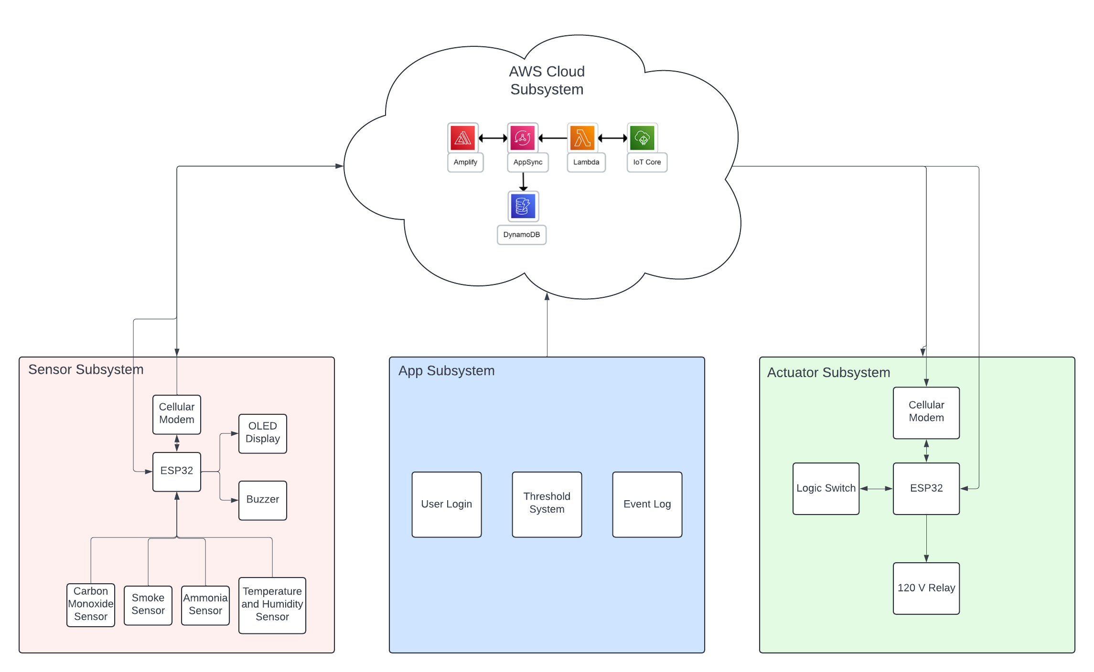
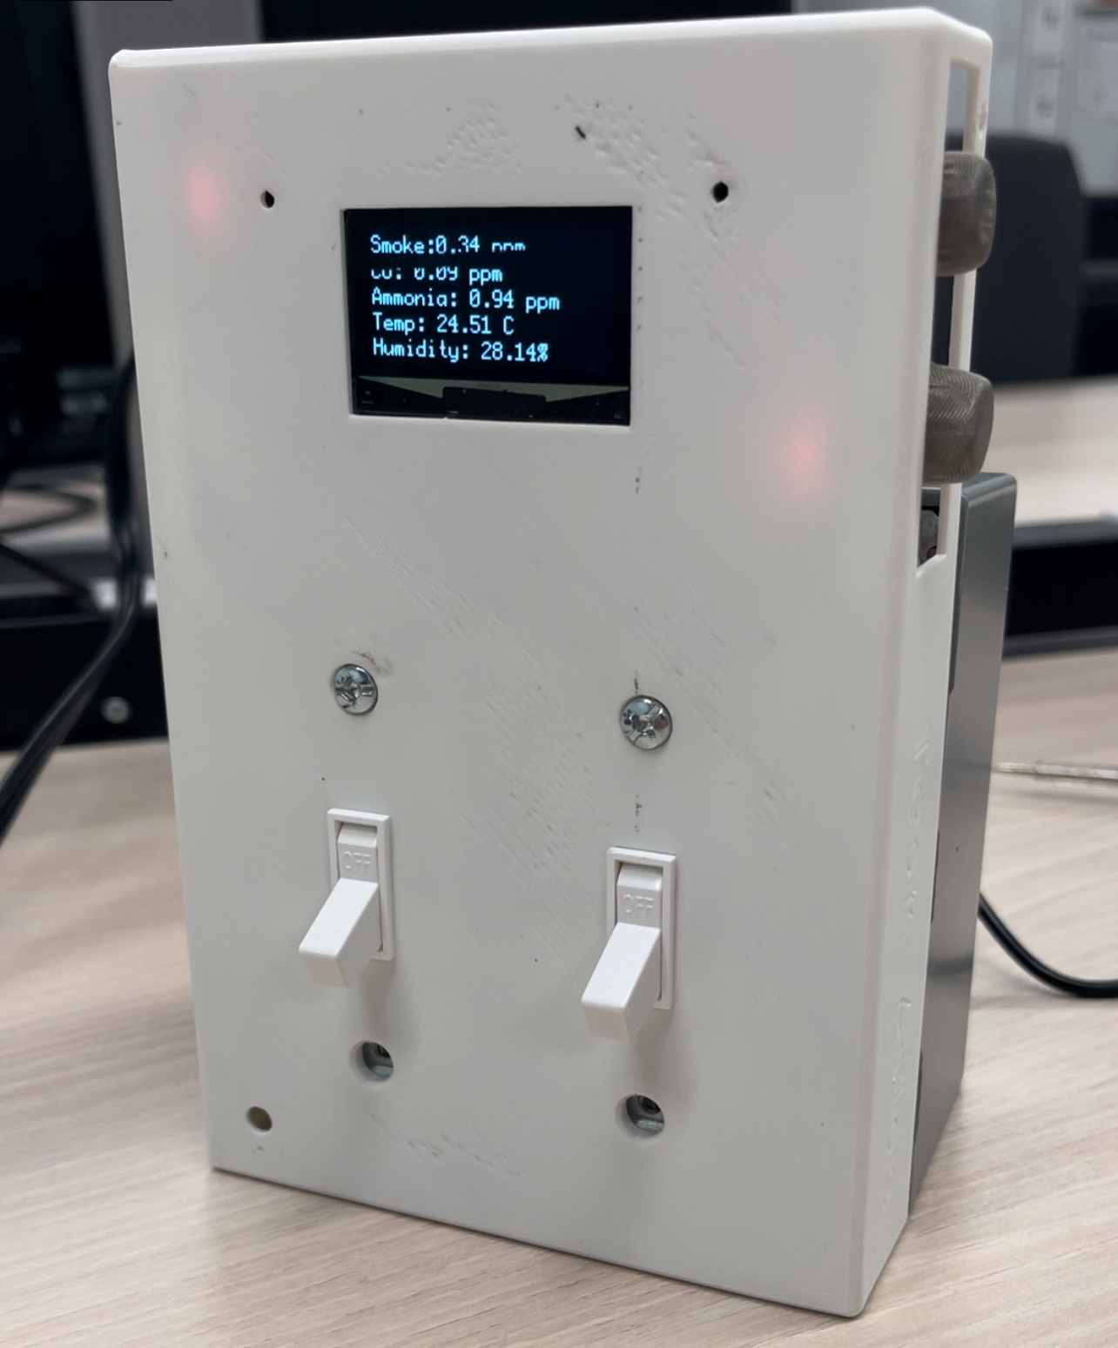
Power Termination, Diversion and Notification using “COSMIC”
Carbon Monoxide – Smoke – Interrupting - Circuit
Team Atlas: Emmanuel Eze, Alberto Rosas, Tanner Roberson, and Samuel Thomas
Faculty Advisor: Robin Pottathuparambil Sponsor: COEVAC LLC.
OBJECTIVE & BACKGROUND
SYSTEM DESIGN
IMPLEMENTATION
1.1 million burns require medical attention, 40,000 burns require hospitalizations, and 10,000 die annually in the United States
Current smoke and fire alarms measures are insufficient
We need to terminate and divert power, and notify homeowners, business owners, EMS, and other authorities in the case a threat arises.
Sensor Subsystem
ESP32 / SIM7000A Cellular Module
OLED Screen
MQ Sensors
Buzzers
Power/Backup Battery
Actuator Subsystem
ESP32 / SIM7000A Cellular Module
Relay
Flip Switch
Cloud Subsystem
AWS Services
- Amplify
- AppSync
- Lambda
- IoT Core
- DynamoDB
Mobile App Subsystem
Flutter
SOLUTION
RESULTS
SUMMARY
The COSMIC Home System aims to reduce the harm caused by toxic gas leaks by creating an innovative home device that can be installed right onto a two-gang light switch box. This system consists of four subsystems:
Sensor Subsystem: Monitors sensor values in real time and communicates with the cloud
Actuator Subsystem: Triggers a relay to turn off an electronic device whenever a threshold is exceeded
Cloud Subsystem: Communicates with other devices and alerts the user when thresholds are exceeded
Mobile App Subsystem: Shows real time data of sensor values, and user-generated thresholds.
Sensor Subsystem:
Successfully monitors and displays real-time sensor data and sends values to the cloud
Included backup battery in case of power failure
Included cellular module in case of WiFi failure.
Actuator Subsystem:
Successfully triggers the relay upon receiving an alert from the cloud
Successfully integrates with 120V devices.
Cloud Subsystem:
Successfully integrates all devices via wireless communication protocols
Stores incident values.
Mobile App Subsystem:
Interfaces the user with real-time sensor data
Allows user to update desired threshold values.
Overall, our project has solved the problems we were presented with.
We learned: To plan for issues to arise ahead of time, so they can be dealt with while still meeting our deadlines
Potential Improvements: Integration of the ESP32 and the cellular module directly onto the PCB would cut down on the size of the system.
ACKNOWLEDGMENTS
Special thanks to:
Robin Pottathuparambil, Project Manager
Dan Combe, COEVAC LLC, Project Sponsor

